Slide 1

MARKET BASKET ANALYSIS & RECOMMENDATION SYSTEM USING ASSOCIATION RULES
Master of Science(statistics)
SCHOOL OF STATISTICS
DEVI AHILYA VISHVAVIDYALAYA, INDORE
Under the supervision of Submitted by:
Dr. SNIGDHA BANERJEE MUSKAN THAKUR
Head of a Department DATE: 2022/12/19

Slide 2
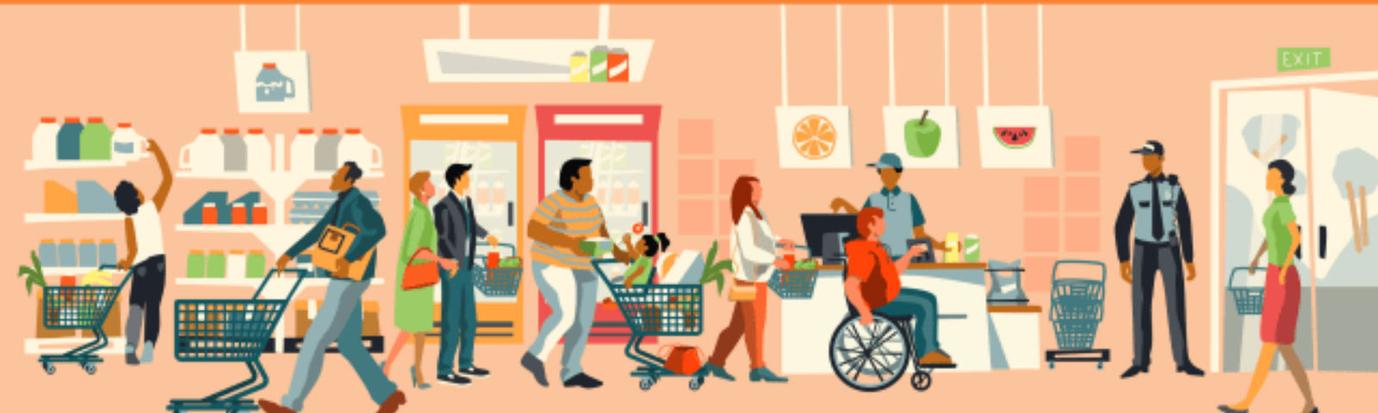
INTRODUCTION
Market Basket Analysis: A data mining technique used by retailers to increase sales by better understanding customer purchasing patterns.
Recommender System: a subclass of information filtering system that seeks to predict the “rating” or “preference” a user would give to an item.

Slide 3
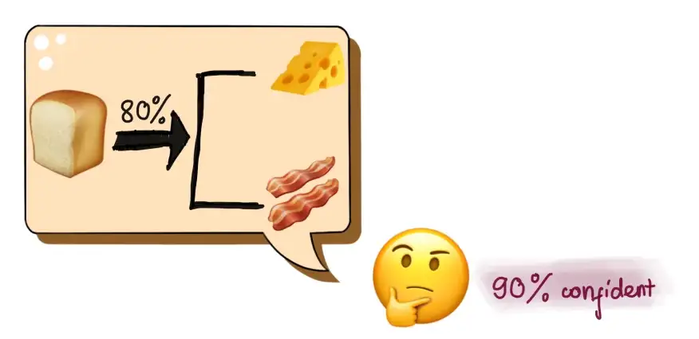
What is association rule mining?
Association rule mining is a procedure which is meant to find frequent patterns, correlations, associations, or causal structures from data sets found in various kinds of databases such as relational databases, transactional databases, and other forms of data repositories.

Slide 4
The specific objectives of the project are as listed below
1. To understand the purchasing pattern of products that comprise the customers basket.
2. To study about many products usually purchased by the customers.
3. To study the most likely products purchased by the customers along with a particular product category.
4. To recommend and suggest products to individual customers.

Slide 5
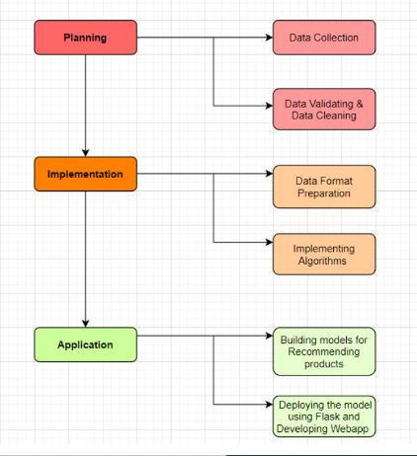
METHODOLOGY

Slide 6
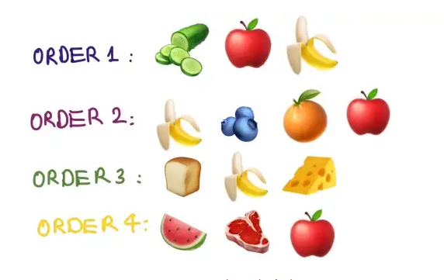
Components of Apriori
Support
Support (bananas)
= Bananas related orders/Total orders
= 3/4 = 0.75
Confidence
Confidence (bananas -> apples)
= support (bananas, apples) / support (bananas)
=(2/4)/(3/4) = 0.6667
Lift
Lift(bananas, apples) = Lift(apples, bananas)
= support(bananas, apples) / (support(bananas) * support(apples))
=(2/4)/(0.75*0.75) = 0.89Revie

Slide 7
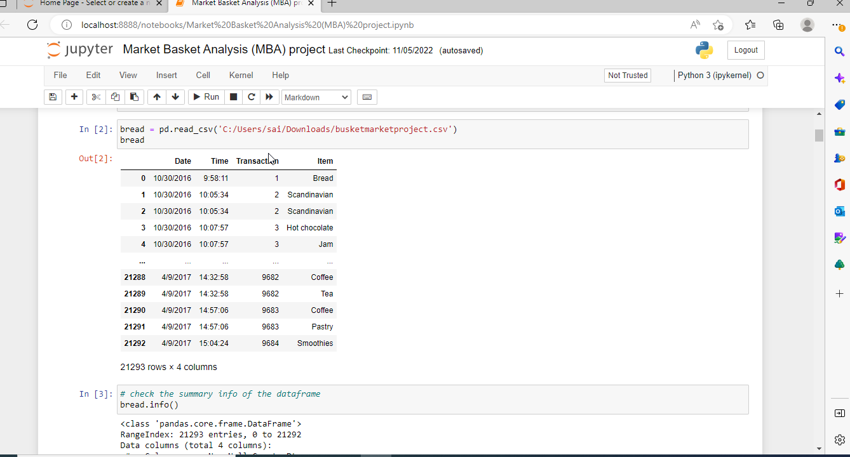
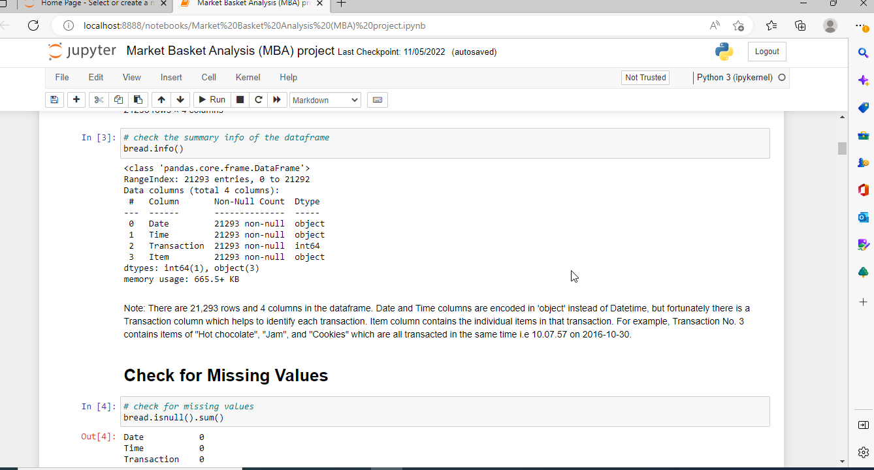
Dataset
The overview of the dataset can be seen below:

Slide 8
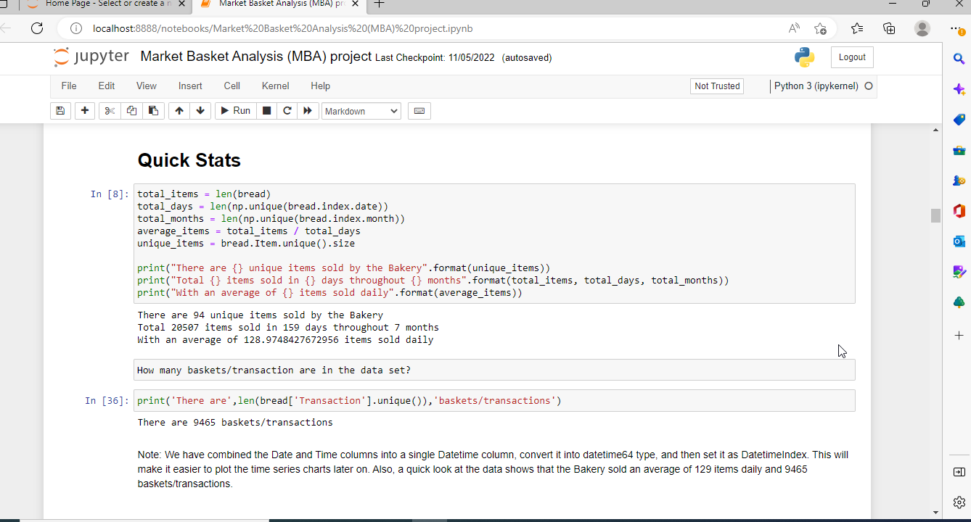
Quick stats

Slide 9
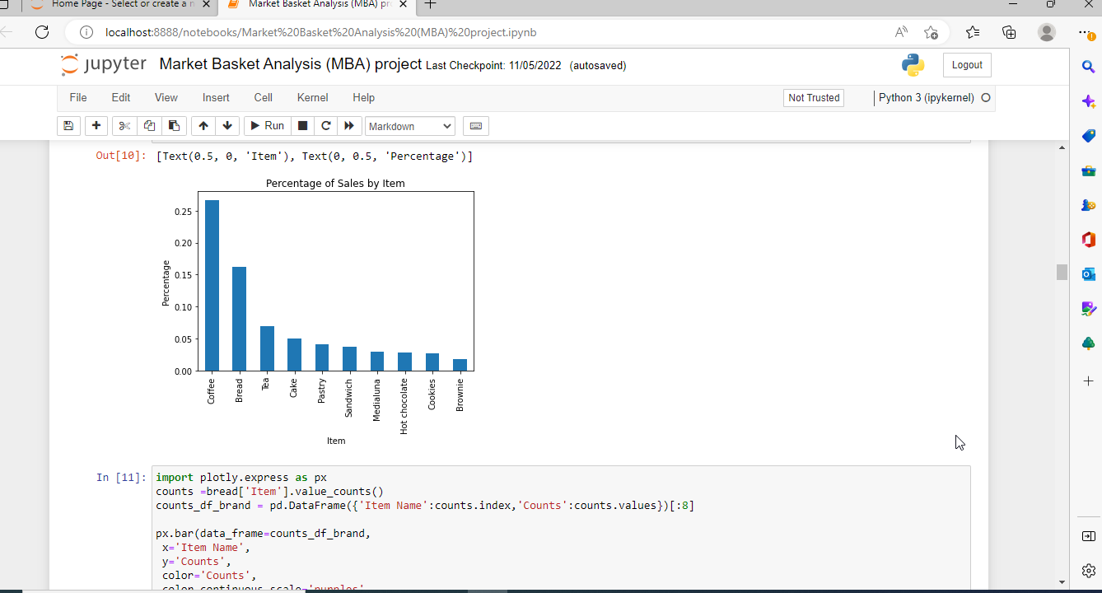
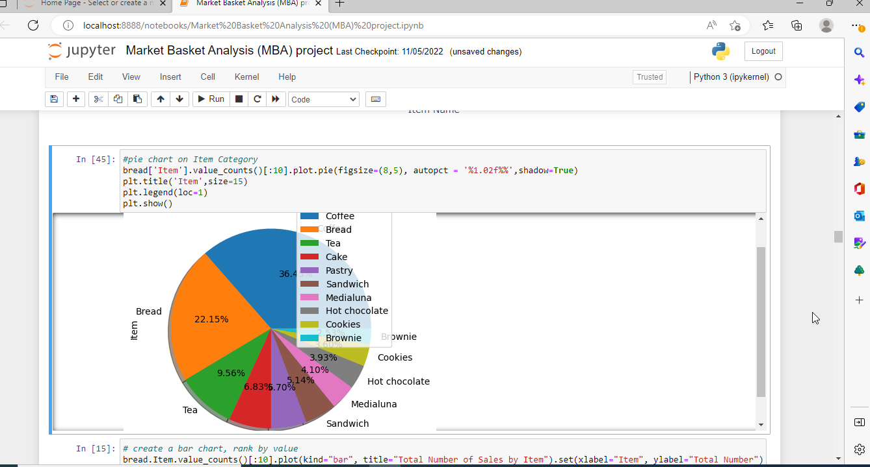
The top 10 items sold are described in the chart below.

Slide 10
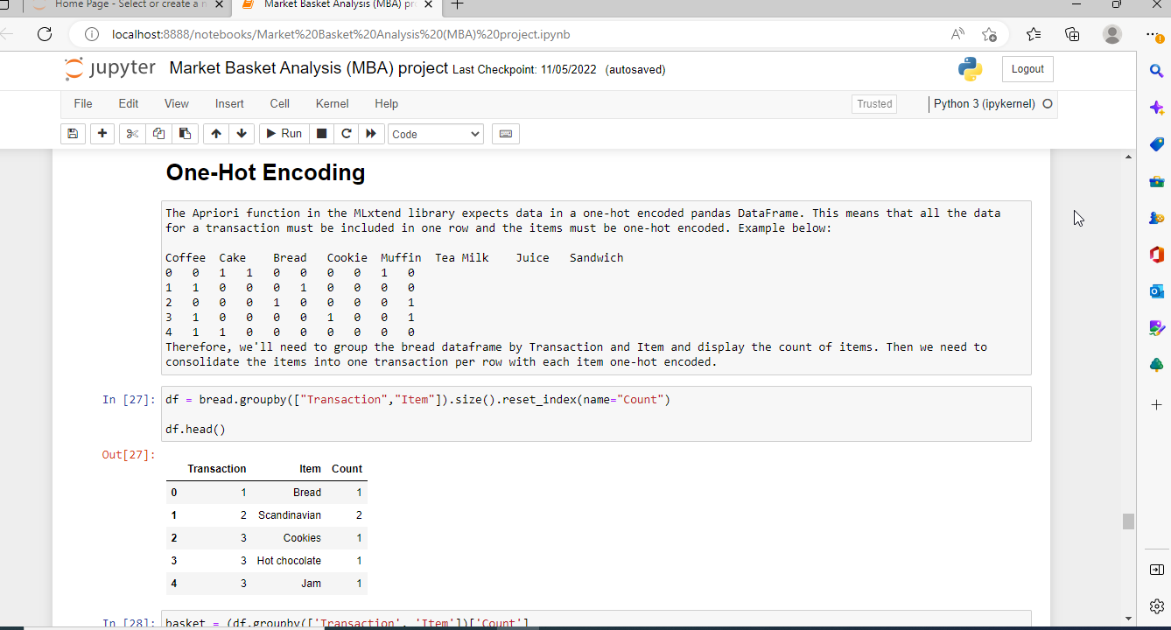
One-Hot Encoding: a one-hot is a group of bits among which the legal combinations of values are only those with a single high bit and all the others low. A similar implementation in which all bits are '1' except one '0' is sometimes called one-cold.

Slide 11
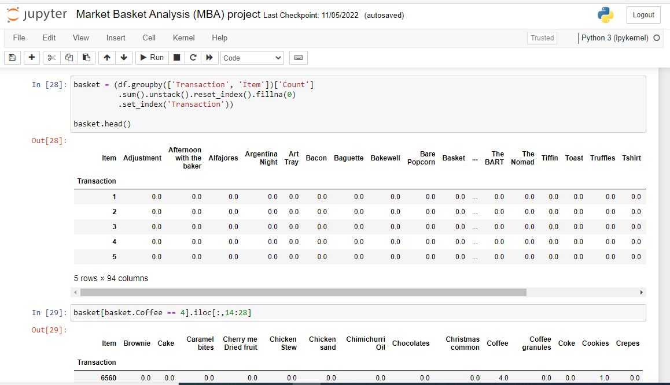
Reshaping Data frame which contains details on products and order ID using unstack ( ) function

Slide 12
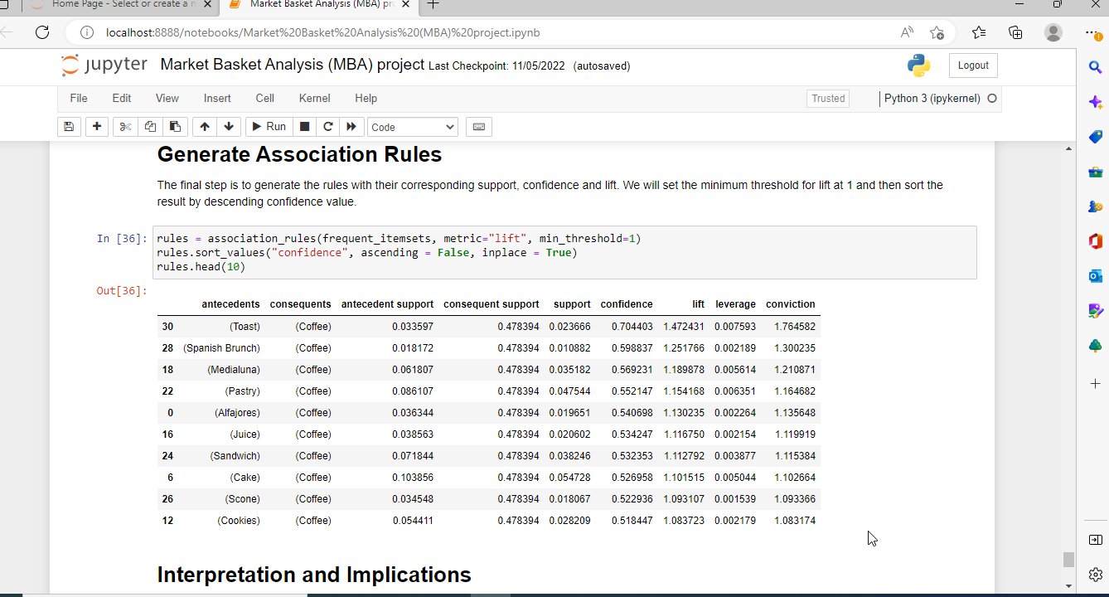
From these frequent sets, I continue to find the association rules which determine if A is bought, then B is also purchased. I set the metric = 'lift' with the minimum threshold = 1.

Slide 13
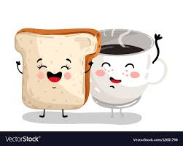
As we can see, the results consist of two association rules only. taost and Coffee are bought more frequently than random with the lift = 1.4 and 70% confidence.

Slide 14
Limits
Although the Apriori algorithm is simple to apply, it still has certain constraints, which include:
The algorithm's efficiency will be reduced if the number of transactions is large and there is a restricted memory capacity.
As it needs to scan the whole database, high processing power is required

Slide 15
Some benefits that can be withdrawn from the method can be mentioned as follows:
Booth arrangement: You may group related goods together. Price combo items based on consumer purchasing habits.
Product recommendations: Product recommendations should be based on user purchasing habits. You may give clients discounts if they buy more combinations. Alternatively, customers may purchase additional goods with a minimum total price.
Inventory Management: Market basket analysis becomes the basis for forecasting future purchases. Besides, sales data is captured concurrently, so maintaining product supply and controlling inventory becomes more efficient.
Optimize Ads Cost: Make the most of your advertising opportunities. Customers’ reactions to messaging, communications, and offers reflect this.

Slide 16
Conclusion
The output above shows the Top 10 itemsets sorted by confidence value and all itemsets have support value over 1% and lift value over 1. The first itemset shows the association rule "if Toast then Coffee" with support value at 0.023666 means nearly 2.4% of all transactions have this combination of Toast and Coffee bought together. We also have 70% confidence that Coffee sales happen whenever a Toast is purchased. The lift value of 1.47 (greater than 1) shows that the purchase of Coffee is indeed influenced by the purchase of Toast rather than Coffee's purchase being independent of Toast. The lift value of 1.47 means that Toast's purchase lifts the Coffee's purchase by 1.47 times.
Therefore, we can conclude that there is indeed evidence to suggest that the purchase of Toast leads to the purchase of Coffee. The owner of the bakery "The Bread Basket" should consider bundling Toast and Cofee together as a Breakfast Set or Lunch Set, the staff in the store should also be trained to cross-sell Coffee to customers who purchase Toast, knowing that they are more likely to purchase them together, thereby increasing the store's revenue.

Slide 17


